Slide 1
ORACLE FUSION HCM
VALERIE ORTMANN
MARIA SHILAMBA

Slide 2
AGENDA
Introduction
Modules
Benefits
Capabilities
Questions and Answers

Slide 3
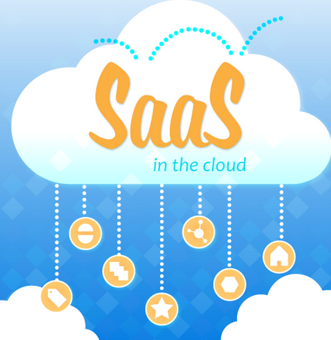
FUSION HCM
Is a SAAS Model
Cloud Computing
Applications delivered to users via web browser
Work as a team, globally

Slide 4
ORACLE FUSION HCM
Enable you to proactively manage HR data for improved businesses
Modern HR empowers the individual by leveraging easy to use tools that are personalized, social, deliver insights and cover the full employee lifecycle.
With Oracle HCM Cloud, you can find, grow, and retain the best talent, enable collaboration, provide complete workforce insights
Increase operational efficiency and make it easy for everyone to connect on any device.

Slide 5
FUSION HCM MODULES

Slide 6
MODULES ……
Global Core Human Capital. Manage human resources globally on a single system and comply with local laws and regulations .
Global Payroll: that pays people accurately, with a global rules engine that powers native payroll for multiple countries in a single system – including local statutory requirements
Absence Management: for better insight, helping you to lower costs and improve retention and productivity

Slide 7
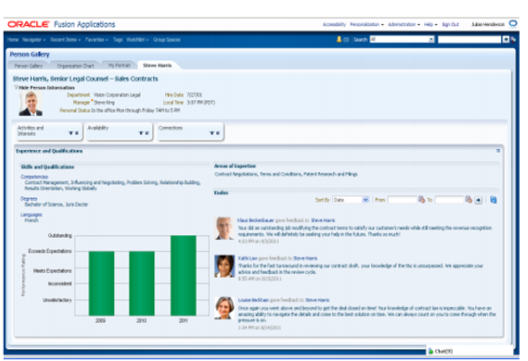
OVERVIEW
MANAGERS
Total picture in one page
Know your employees Better
Fast and easy Communication
EMPLOYEES
Know your colleagues better
Communicate more about your work
Fast and easy updates

Slide 8
WHY FUSION HCM …?
TIMEFRAME
Rapid time to Value/Use
Less Implementation Time Required
Quick ROI
Release go live
Simple Configuration
Limited Data Loads
Application Workshops
Solution Review
Configuration of SAAS Application
IMPLEMENTATION

Slide 9
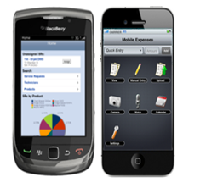
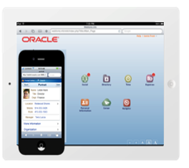
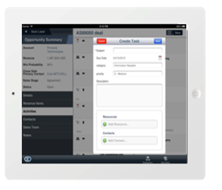
HCM CAPABILITIES
CLOUD APP FOR TABLETS AND SMART PHONES

Slide 10
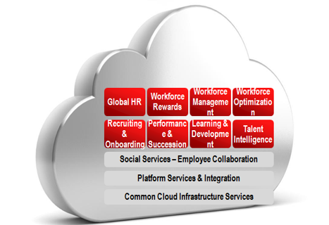
TRANSFORMATION TO FUSION HCM
ORACLE
E-BUSINESS SUITE
Data load/migration
Adopt Full Capabilities within the Fusion HCM
ORACLE PEOPLESOFT HCM

Slide 11
THANK YOU

